Slide 1
Sentiment Analysis Of Social Media Texts In Using Transformers
g]kfnL
A Dissertation Proposal Report
By Regan Maharjan
Roll no. 17/75

Slide 2
OUTLINE
Introduction: Nepali Sentiment Analysis and Use of Transformers
The Objective of the Study
Transformer
Literature Review
Research Methodology

Slide 3
Sentiment Analysis (SA)
Sentiment Analysis (SA) is the task of identifying and extracting the polarity (positive, negative, and neutral) or emotion and subjective opinions in natural language texts.
SA helps in understanding public opinions and sentiments expressed on digital platforms including social media platforms.

Slide 4
Why Sentiment Analysis of social media texts in g]kfnL?
Social Media platforms have become ubiquitous with the growing usage of smartphones and the availability of the internet.
A growing number of people, businesses, and organizations prefer the Devanagari script as the language of communication on social media platforms. Just on Twitter, more than 20,000 tweets are made, in a day, in Devanagari (code-mixed).
However, very few transformer models are available that are trained on Nepali text datasets, thus lacking support and tools for the sentiment analysis of Nepali texts.

Slide 5
Why Transformer?
In recent years, transformer architecture has revolutionized the field of Natural Language Processing (NLP) [4].
They can capture long-range dependencies (context) and learn contextual representations of words and sentences, which had been a bottleneck with RNNs as they couldn’t carry along long-range dependencies [2].
The top 10 models in the General Language Understanding Evaluation (GLUE) benchmark leaderboard are Transformer based models.

Slide 6
Objectives of the Study
To train and evaluate different transformer-based models on the available datasets for SA in the Nepali language (Devanagari Script).
To study how well the transformer-based models perform compared to other Neural Network Architectures.
To investigate methods to improve the performance of transformer-based models on Nepali sentiment anlaysis using techniques such as data augmentation, domain adaptation, etc.

Slide 7
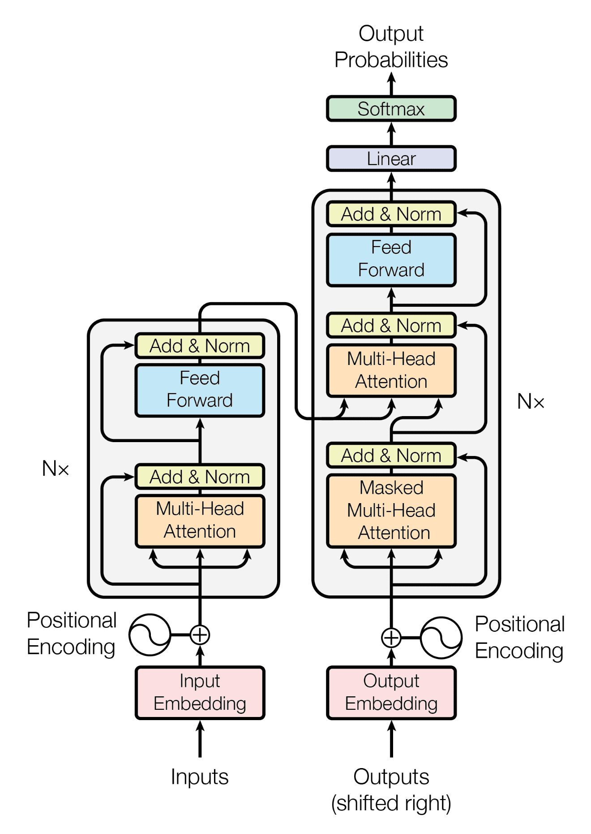
How Transformers Work?
It was first proposed by [2] as a sequence-to-sequence model, for machine translation.
Transformer architectures rely on attention mechanisms [3] to encode and decode sequential data.
Transformer, or attention mechanism, can’t inherently capture positional information (like RNNs). Hence, a positional encoding is embedded into input embeddings to incorporate positional information of entities (tokens) in the sequence.
Implements multi-head attention i.e. more than one attention that allows the model to jointly attend to information from different representation subspaces at different positions.
Transformer Model [2]

Slide 8
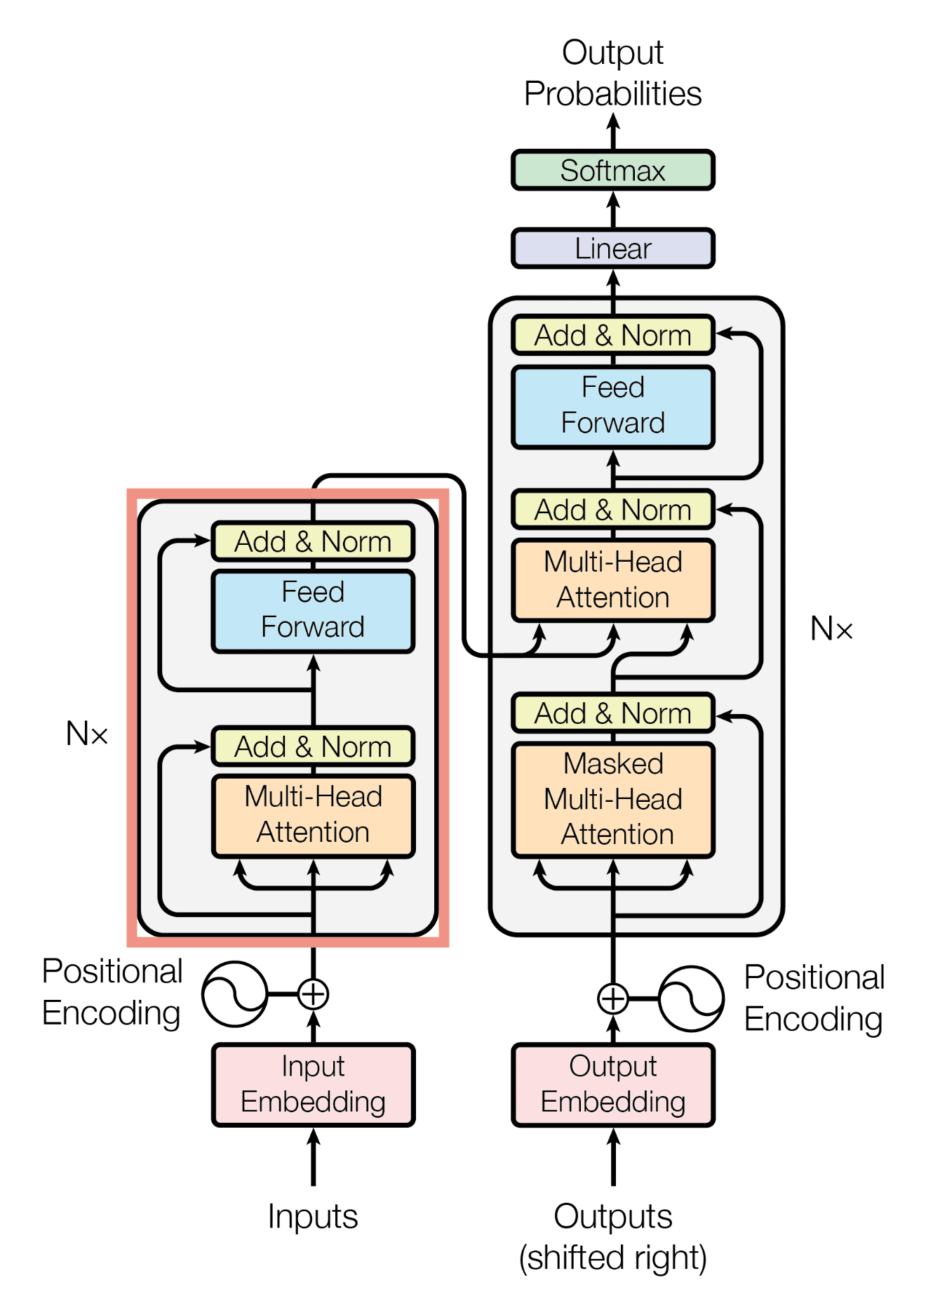
The Encoder
Implements Self-Attention.
The encoder processes the whole input text (tokenized) at once.
Bidirectional
Learns language representation, syntax, and semantics.
Encoder Only Transformer BERT [5]

Slide 9
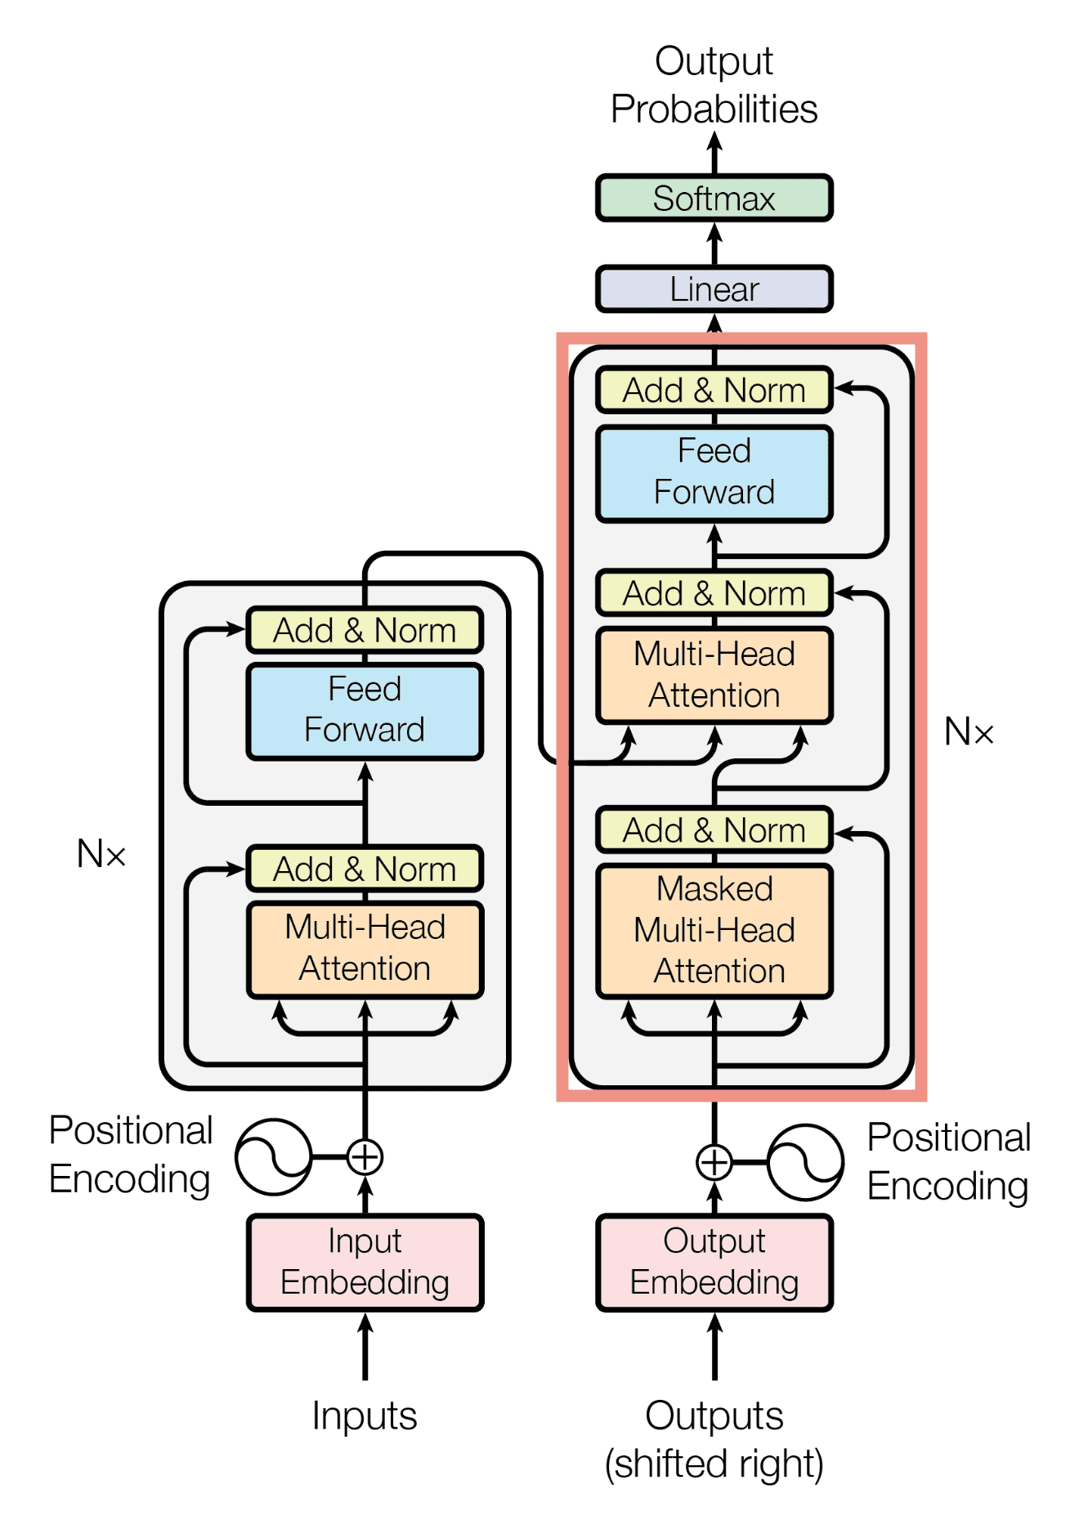
The Decoder
Implements Causal Self-Attention and Cross-Attention.
It is sequential and processes each token one after another.
Unidirectional (Left to Right)
Learns language representation, syntax, and semantics
Generates language based on previously seen tokens.
Decoder-only transformer GPT [6]

Slide 10
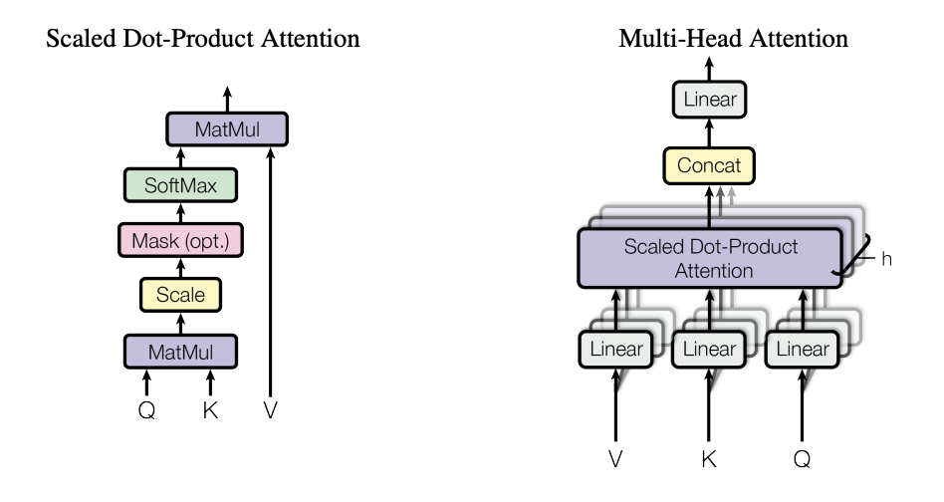







Attention Mechanism
$$Attention(Q, K, V ) = softmax(\frac{QK^{T}}{\sqrt{d_{k}}})V$$
here,
$Q = X ∗ W_{Q}$
$K = X ∗ W_{K}$
$V = X ∗ W_{V}$
where,
‘X’ is the input (embedding) sequence and W_{Q}, W_{K,} and W_{V} are learnable weights for, Q(query), K(key), and V(value), respectively
‘h ’ is the number of attention heads.
d_{k} = d_{v} = d_{model}/h . The d_{model} is a vector returned by the encoder/decoder block.

Slide 11
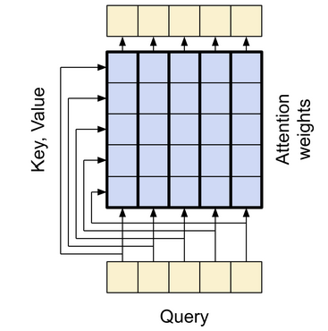
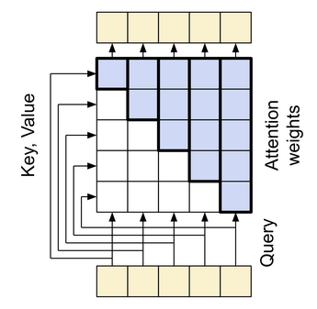
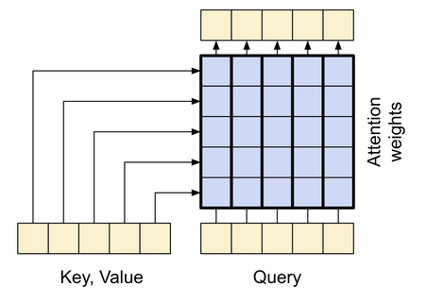
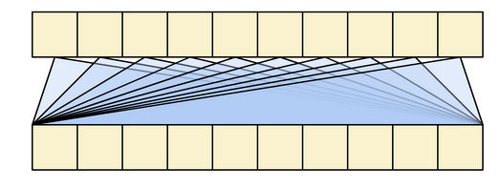
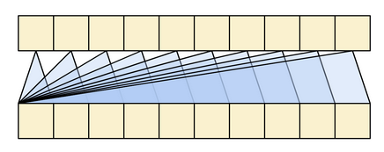
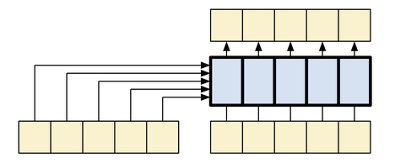
Attention Mechanism
(i) Global Self-Attention (ii) Causal Self-Attention (iii) Cross Attention [25]

Slide 12
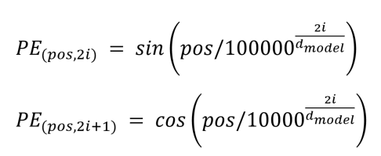
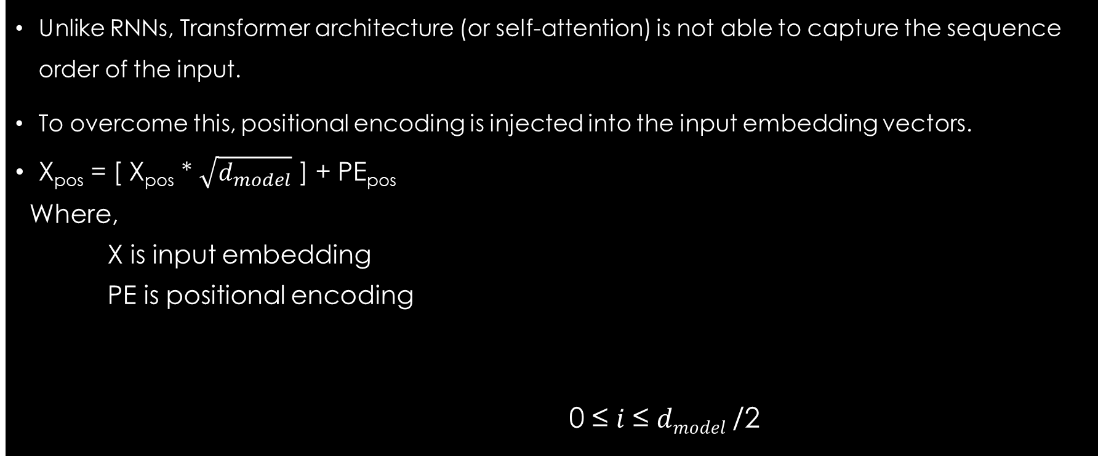
Positional Encoding
Unlike RNNs, Transformer architecture (or self-attention) is not able to capture the sequence order of the input.
To overcome this, positional encoding is injected into the input embedding vectors.
X_{pos} = [ X_{pos} * $\sqrt{d_{model}}$ ] + PE_{pos}
Where,
X is input embedding
PE is positional encoding
0 ≤ 𝑖 ≤ 𝑑_{𝑚𝑜𝑑𝑒𝑙} /2

Slide 13
Literature Review
Most of the works on Sentiment Analysis of Nepali texts are based on ML-based approaches (mostly SVM and others) and Deep learning-based approaches [9][10][11][12][13].
There are not many works related to Sentiment Analysis using Transformer models. Only one work was found, that reports the performance of mBERT compared to BiLSTM, CNN, and SVM [10].
Some works have been done in news classification using transformer models. All of those works show that one or the other BERT-based models perform better than ML-based (SVM, RF, etc.) approaches and other deep learning approaches [16][17][18].
Only 2 Nepali only Pre-trained BERT Language Models (LM) are available, namely NepaliBERT and NepBERTa [14][15]. Other than that, there is one distilBERT and one DeBERTa model[16].
There are no known Nepali-only Pre-Trained GPT-based LMs available. Thus, there hasn’t been any work done on SA with a GPT model on Nepali texts.

Slide 14
Research Methodology
Data Collection
Data Preprocessing
Model Architecture Selection
Pre-training and Fine-tuning
Feature Extraction & Hybrid Approaches
Evaluation

Slide 15
Research Methodology
Data Collection:
Make use of the already available Nepali Sentiment analysis dataset.
NepCov19Tweets [11]
Collect data from one of the social media platforms and label it.
Data Preprocessing:
Cleaning
Normalization
Tokenization

Slide 16
Research Methodology
Model Architecture:
Primarily Focus on BERT and GPT-2 model.
If possible explore other encoder-only and decoder-only transformer models.
4. Pre-training and Fine-Tuning:
Available transformer-based Nepal Language models will be used, otherwise, a pre-training of a language model will be attempted.
Then the fine-tuning of these models will be done for SA.

Slide 17
Research Methodology
5. Feature Extraction and Hybrid Approaches:
Transformer models are self-sufficient and don’t necessarily require external features.
6. Evaluation:
Performance evaluation of the fine-tuned models will be done using evaluation metrics like F1-score, accuracy, etc.
7. Tools and Libraries:
Huggingface, Tensorflow/Keras, Trax, Scikit-Learn, Matplotlib, Seaborn.

Slide 18
Expected Outcome
Analysis of BERT and GPT model on sentiment analysis of Nepali text.

Slide 19
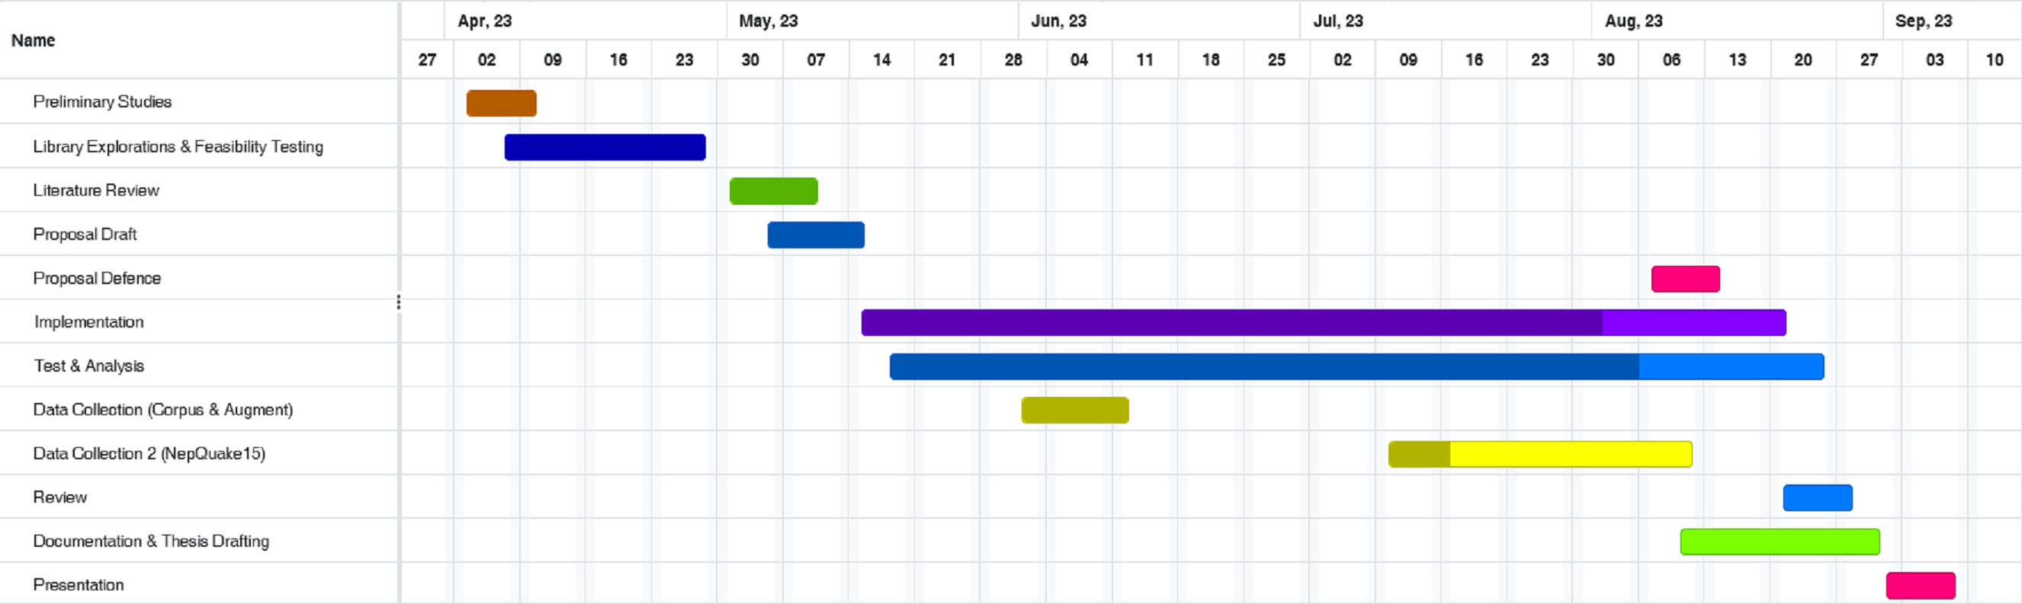
Time Schedule
Gantt Chart

Slide 20
References
[1] T. B. Shahi and C. Sitaula, "Natural language processing for Nepali text: a review,“ Artificial Intelligence Review, Springer, vol. 55, pp. 3401-3429, 2021.
[2] A. Vaswani, N. Shazeer, N. Parmar, J. Uszkoreit, L. Jones, N. A. Gomez, L. Kaiser and I. Polosukhin, "Attention Is All You Need," in 31st Conference on Neural Information Processing Systems (NIPS 2017), Long Beach, CA, USA, 2017.
[3] D. Bahdanau, K. Cho and Y. Bengio, "NEURAL MACHINE TRANSLATION BY JOINTLY LEARNING TO ALIGN AND TRANSLATE," in ICLR , 2015.
[4] R. Bommasani, D. A. Hudson, E. Adeli, R. Altman, S. Arora, S. v. Arx, M. S. Bernstein, J. Bohg, A. Bosselut, E. Brunskill, E. Brynjolfsson, S. Buch, D. Card, R. Castellon, N. Chatterji and others.., "On the Opportunities and Risks of Foundation Models," 2022.
[5] J. Devlin, M.-W. Chang, K. Lee and K. Toutanova, "BERT: Pre-training of Deep Bidirectional Transformers for Language Understanding," Google AI Language, 2019.

Slide 21
References
[6] A. Radford and K. Narasimhan, "Improving Language Understanding by Generative Pre-Training," 2018.
[7] A. Radford, J. Wu, R. Child, D. Luan, D. Amodei and I. Sutskever, "Language Models are Unsupervised Multitask Learners," OpenAI.
[8] T. B. Brown, B. Mann, N. Ryder, M. Subbiah, J. Kaplan, P. Dhariwal, A. Neelakantan, P. Shyam, G. Sastry, A. Askell, S. Agarwal, A. Herbert-Voss, G. Krueger, T. Henighan, R. Child, A. Ramesh and Dani, "Language Models are Few-Shot Learners," Open AI, 2020.
[9] C. P. Gupta and B. K. Bal, "Detecting Sentiment in Nepali Texts: A Bootstrap Approach for Sentiment Analysis of texts in the Nepali Language".
[10] O. M. Singh, S. Timalsina, B. K. Bal and A. Joshi, "Aspect Based Abusive Sentiment Detection in Nepali Social Media Texts," in IEEE/ACM International Conference on Advances in Social Networks Analysis and Mining (ASONAM), 2020.

Slide 22
References
[11] C. Sitaula, A. Basnet, A. Mainali and T. B. Shahi, "Deep Learning-Based Methods for Sentiment Analysis on Nepali COVID-19-Related Tweets," Computational Intelligence and Neuroscience, 2021.
[12] T. B. Shahi, C. Sitaula and N. Paudel, "A Hybrid Feature Extraction Method for Nepali COVID-19-Related Tweets Classification".
[13] C. Sitaula and T. B. Shahi, "Multi-channel CNN to classify Nepali Covid-19 related tweets," 2022.
[14] S. Pudasaini, A. Tamang, S. Lamichhane, S. Adhikari, S. Adhikari, S. Thapa and J. Karki, "Pre-training of Masked Language Model in Nepali," in 36th Conference on Neural Information Processing Systems, 2022.
[15] M. Gautam, S. Timalsina and B. Bhattarai, "NepBERTa: Nepali Language Model Trained in a Large Corpus," in Proceedings of the 2nd Conference of the Asia-Pacific Chapter of the Association for Computational Linguistics and the, 2022.

Slide 23
References
[16] U. Maskey, M. Bhatta, S. R. Bhatta, S. Dhungel and B. K. Bal, "Nepali Encoder Transformers: An Analysis of Auto Encoding Transformer Language Models for Nepali Text Classification," in Proceedings of SIGUL2022 @LREC2022, 2022.
[17] S. Suwanchai, S. R. Tamrakar and Chaklam, "Comparative Evaluation of Transformer-Based Nepali Language Models," [Online]. Available: https://assets.researchsquare.com/files/rs-2289743/v1/aa3f3ba4a38a880db3d6c5dc.pdf?c=1670229384. [Accessed 19 06 2023].
[18] K. Kafle, D. Sharma, A. Subedi and A. K. Timalsina, "Improving Nepali Document Classification by Neural Network," in Proceedings of IOE Graduate Conference, 2016.
[19] T. B. Shahi and A. K. Pant, "Nepali News Classification using Naive Bayes, Support Vector Machines and Neural Networks," in International Conference on Communication, Information & Computing Technology (ICCICT), Mumbai, 2018.
[20] O. M. Singh, "Nepali Multi-Class Text Classification," 2018. [Online]. Available: https://oya163.github.io/assets/resume/Nepali_Text_Classification.pdf. [Accessed 19 6 2023].

Slide 24
References
[21] V. Sanh, L. Debut, J. Chaumond and T. Wolf, "DistilBERT, a distilled version of BERT: smaller, faster, cheaper and lighter," in Conference on Empirical Methods in Natural Language Processing (EMNLP), 2020.
[22] P. He, X. Liu, J. Gao and W. Chen, "DeBERTa: Decoding-enhanced BERT with Disentangled Attention," in ICLR , 2021.
[23] Y. Liu, M. Ott, N. Goyal, J. Du, M. Joshi, D. Chen, O. Levy, M. Lewis, L. Zettlemoyer and V. Stoyanov, "RoBERTa: A Robustly Optimized BERT Pretraining Approach," 26 7 2019. [Online]. Available: https://arxiv.org/pdf/1907.11692.pdf. [Accessed 23 06 2023].
[24] A. Conneau, K. Khandelwal, N. Goyal, V. Chaudhary, G. Wenzek, F. Guzmán, E. Grave, M. Ott, L. Zettlemoyer and V. Stoyanov, "Unsupervised Cross-lingual Representation Learning at Scale," arXiv, 2019.
[25] "Neural Machine Translation with a Transformer and Keras," Tensorflow, 03 06 2023. [Online]. Available: https://www.tensorflow.org/text/tutorials/transformer. [Accessed 2406 2023].

Slide 25
Sentiment Analysis Of Social Media Texts In Using Transformers
g]kfnL
A Dissertation Proposal Report
By Regan Maharjan
Roll no. 17/75

